Slide 1




Practical Machine Learning
For the Average Joe Developer
github.com/mahdi-ninja/ddd-ml

Slide 2



Target Audience
I don’t care about ML!
Wrong room?!
Give me the 5 min version
Let’s talk Azure ML
I’m looking for a new hobby. It may get serious…
I’ll show you the way
I’m a ML researcher and I need help with my latest paper!
Seriously, have you checked other talks?

Slide 3
What can you do right now?
Mobile app to identify objects in real-time
https://codelabs.developers.google.com/codelabs/tensorflow-for-poets/
Style Transfer
https://github.com/lengstrom/fast-style-transfer/
Write like Shakespeare
http://karpathy.github.io/2015/05/21/rnn-effectiveness/
Generate “scientific” papers
http://karpathy.github.io/2015/05/21/rnn-effectiveness/

Slide 4
Mobile app to identify objects in real-time

Slide 5
Style Transfer

Slide 6
Write like Shakespeare

Slide 7
Generate “scientific” papers

Slide 8
What do you get out of this?
Basic concepts
Enough to get you started
Understanding the “magic” behind Neural Networks
It’s not that hard (just kidding!)
How to write code for ML
Cause that’s what we love?!
Where to go from here

Slide 9
Mobile app to identify objects in real-time

Slide 10
Style Transfer

Slide 11
Write like Shakespeare

Slide 12
Generate “scientific” papers

Slide 13


What are we talking about?
Artificial Intelligence
Mimic human behaviour
Machine Learning
Improve with experience
Deep Learning
Machine Learning with Deep Neural Networks
AI
ML
DL

Slide 14
Machine Learning
Machine Learning
Algorithm: A generic algorithm that can be applied to a wide range of problems
Training: Feed data to the algorithm to adjust it for a specific problem
General categories of Machine Learning
Supervised learning
Unsupervised learning
Reinforcement learning

Slide 15
Supervised learning
Find general rules using example inputs and their desired outputs (labels)
Example problems:
Classification: Output is a category e.g. “spam” and “not spam”
Regression: Output is a real value e.g. predicting stock price

Slide 16
Unsupervised learning
Unsupervised learning
Find structures in the data
Example problems:
Clustering: Organising data into groups whose members are similar e.g. group customers with similar behaviours
Anomaly detection: Identification of items which do not conform to an expected pattern e.g. fraud detection

Slide 17
Reinforcement learning
Reinforcement learning
Learn steps to reach a goal by interacting and receiving feedback in a dynamic environment
Example problems:
Game playing: Learn by playing the game e.g. playing Go
Optimal control problems: Solve complex nonlinear problems e.g. walking robot

Slide 18
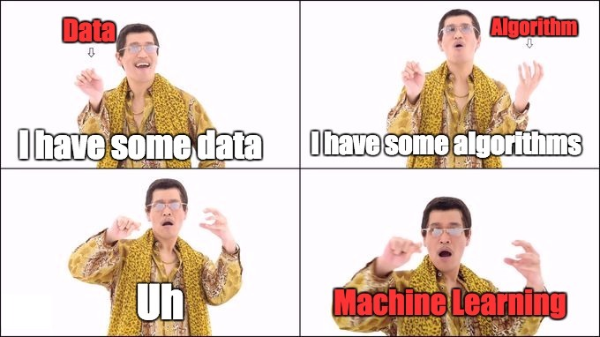

Machine Learning (in 5 mins)

Slide 19
Machine Learning Steps
Prepare data
Choose an algorithm
Train the model(s) using “training” data
Choose the best model using “validation” data
Test the model using “test” data
Use different set of data to avoid overfitting
Overfitting: “memorising” instead of “generalising”

Slide 20
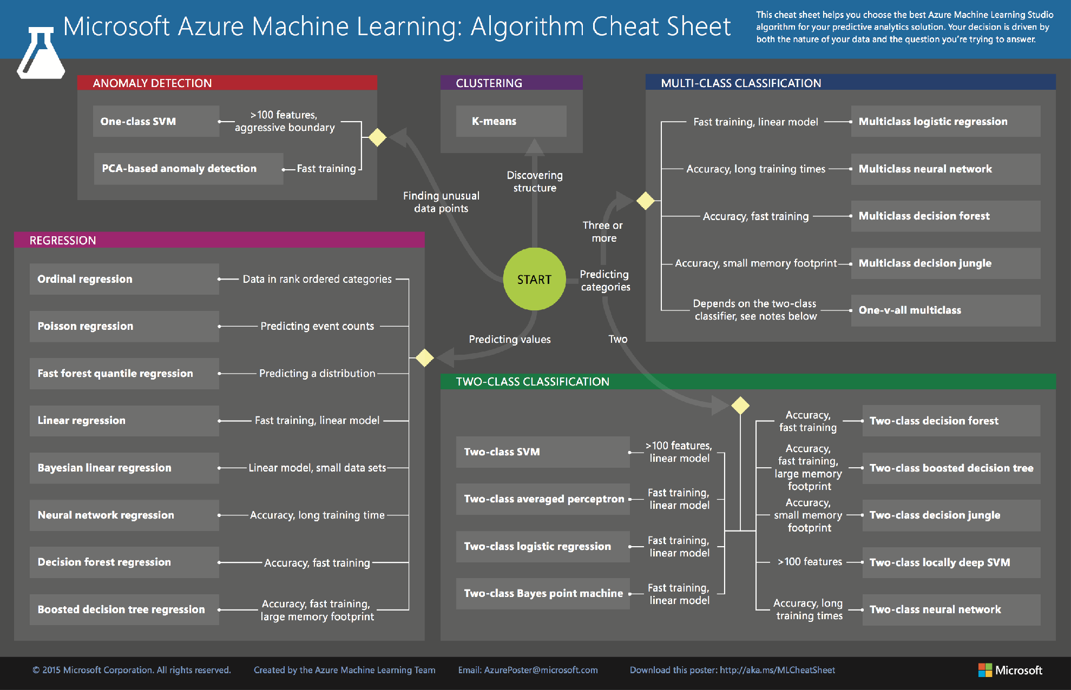
Azure ML Cheat Sheet

Slide 21
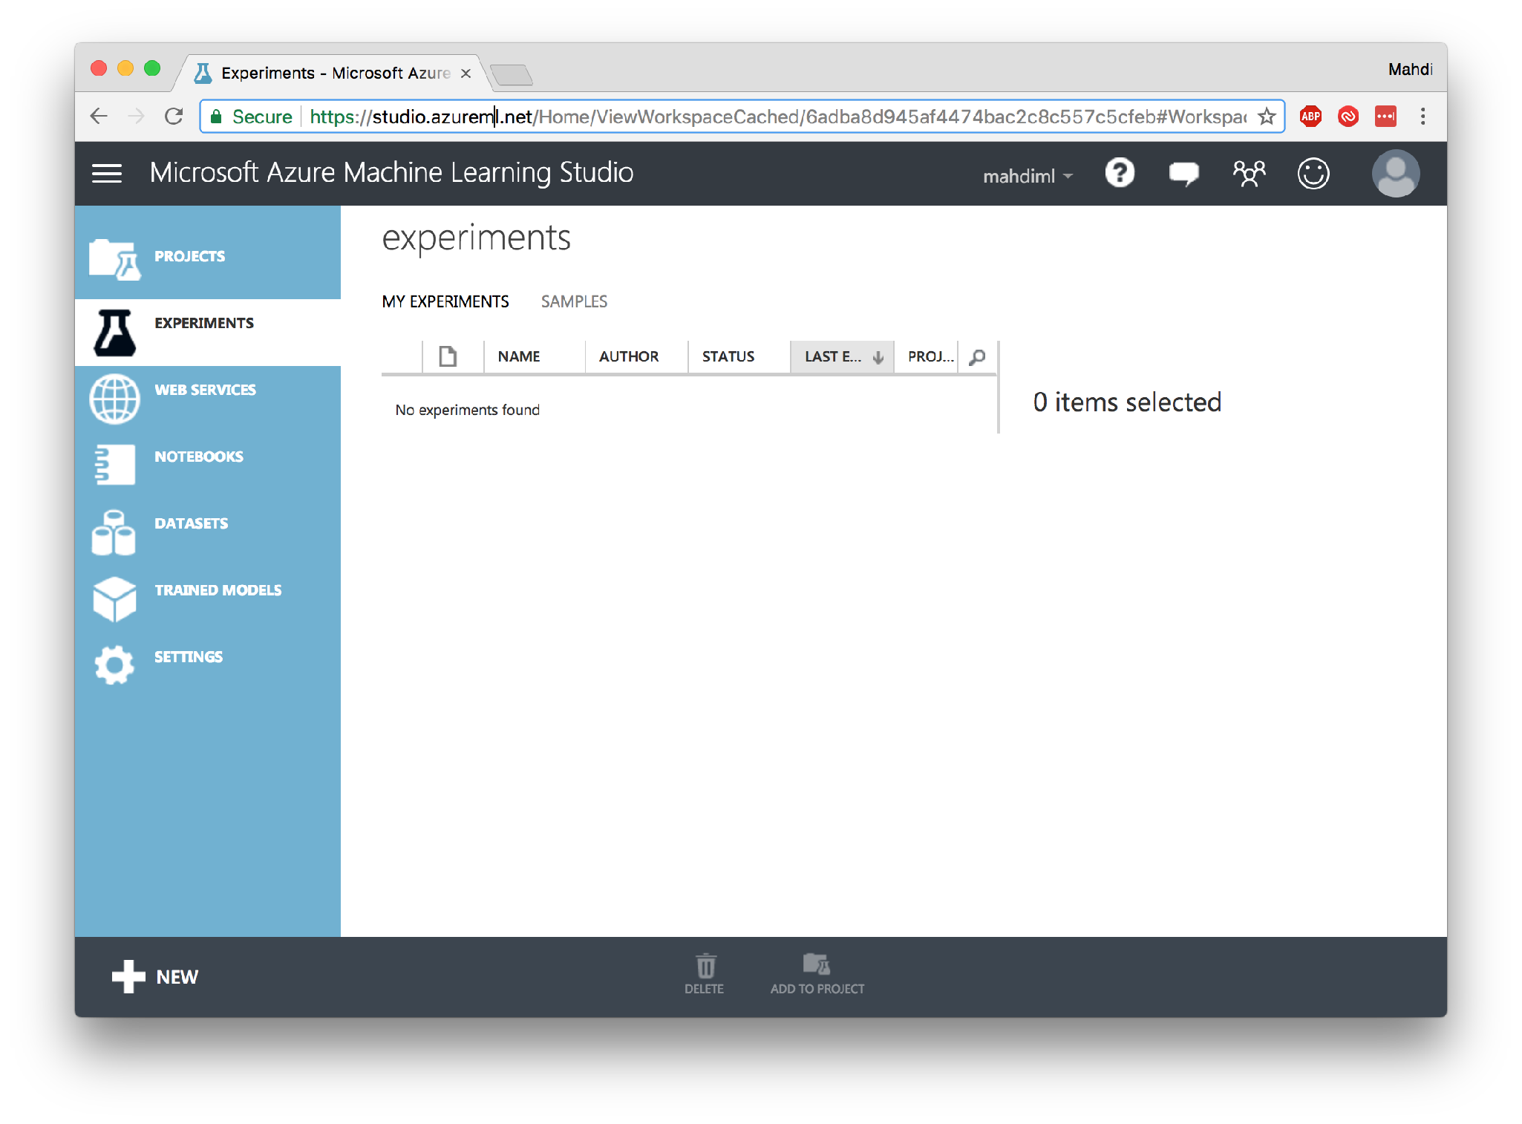

Slide 22
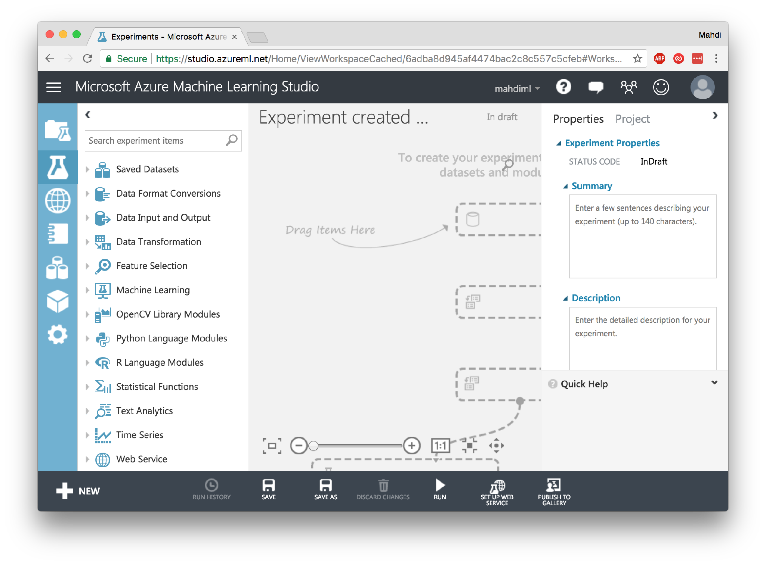

Slide 23
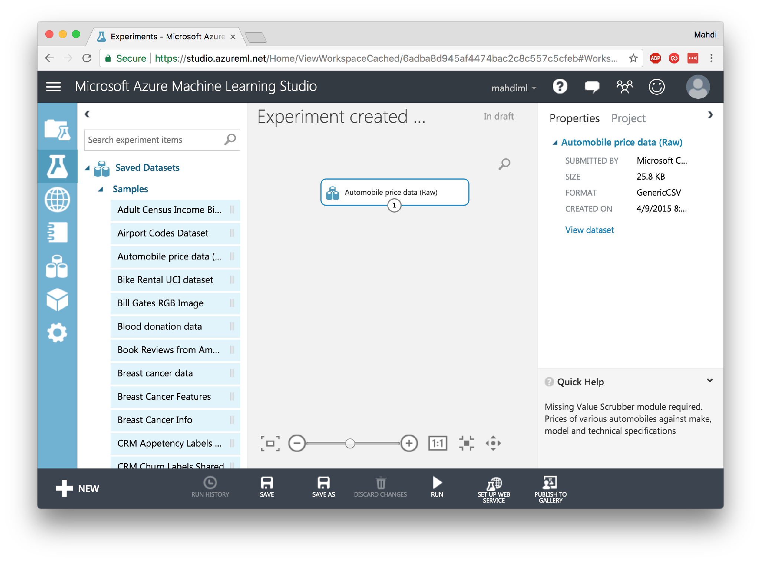

Slide 24
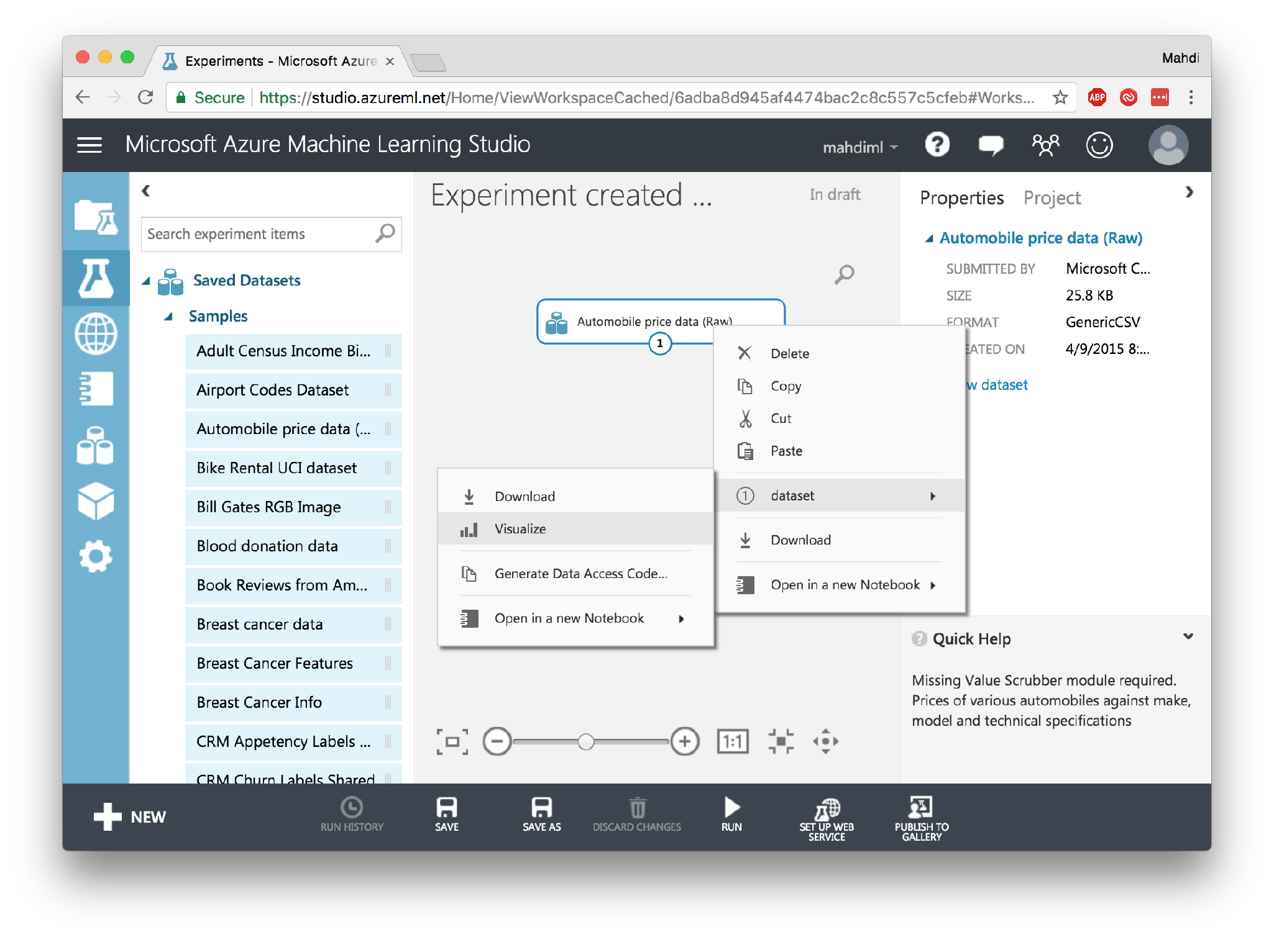

Slide 25
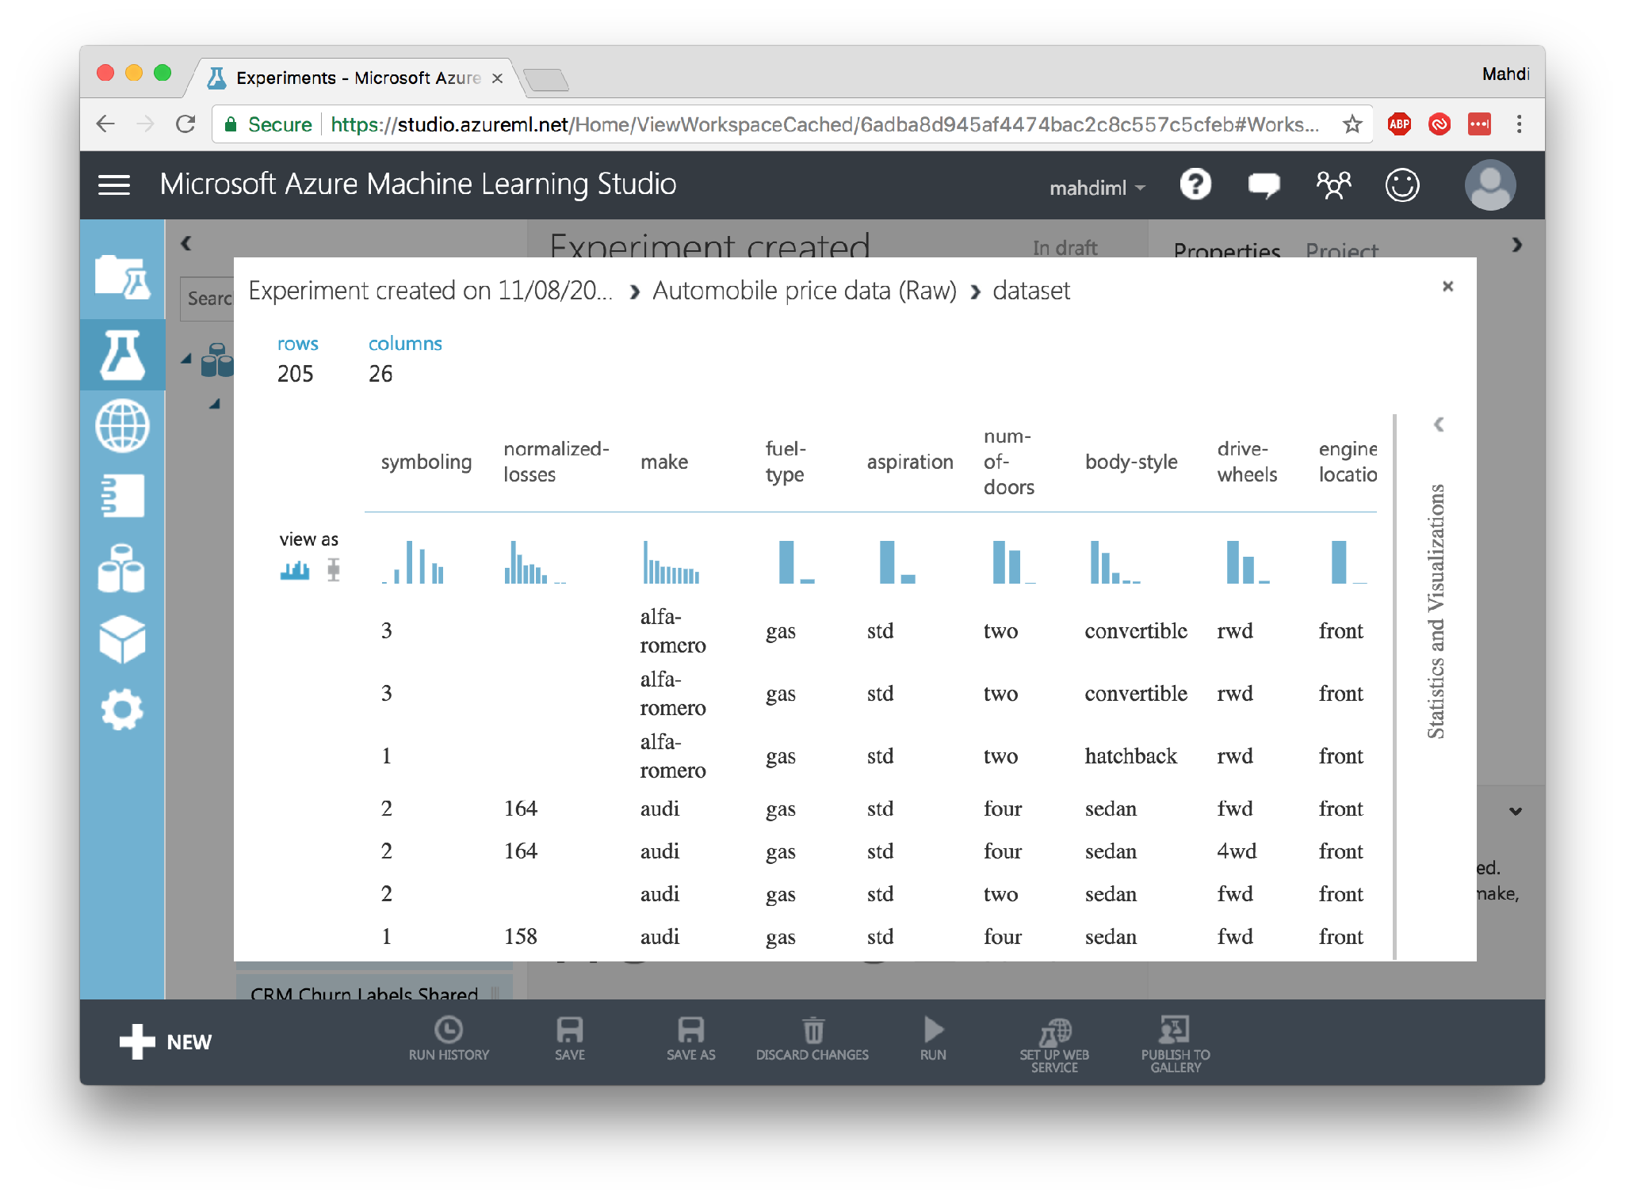

Slide 26
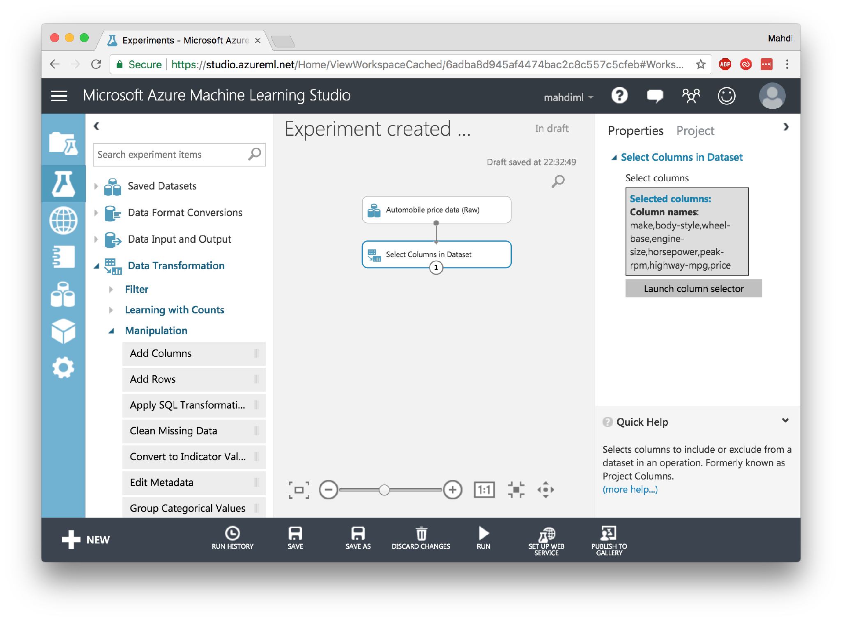

Slide 27
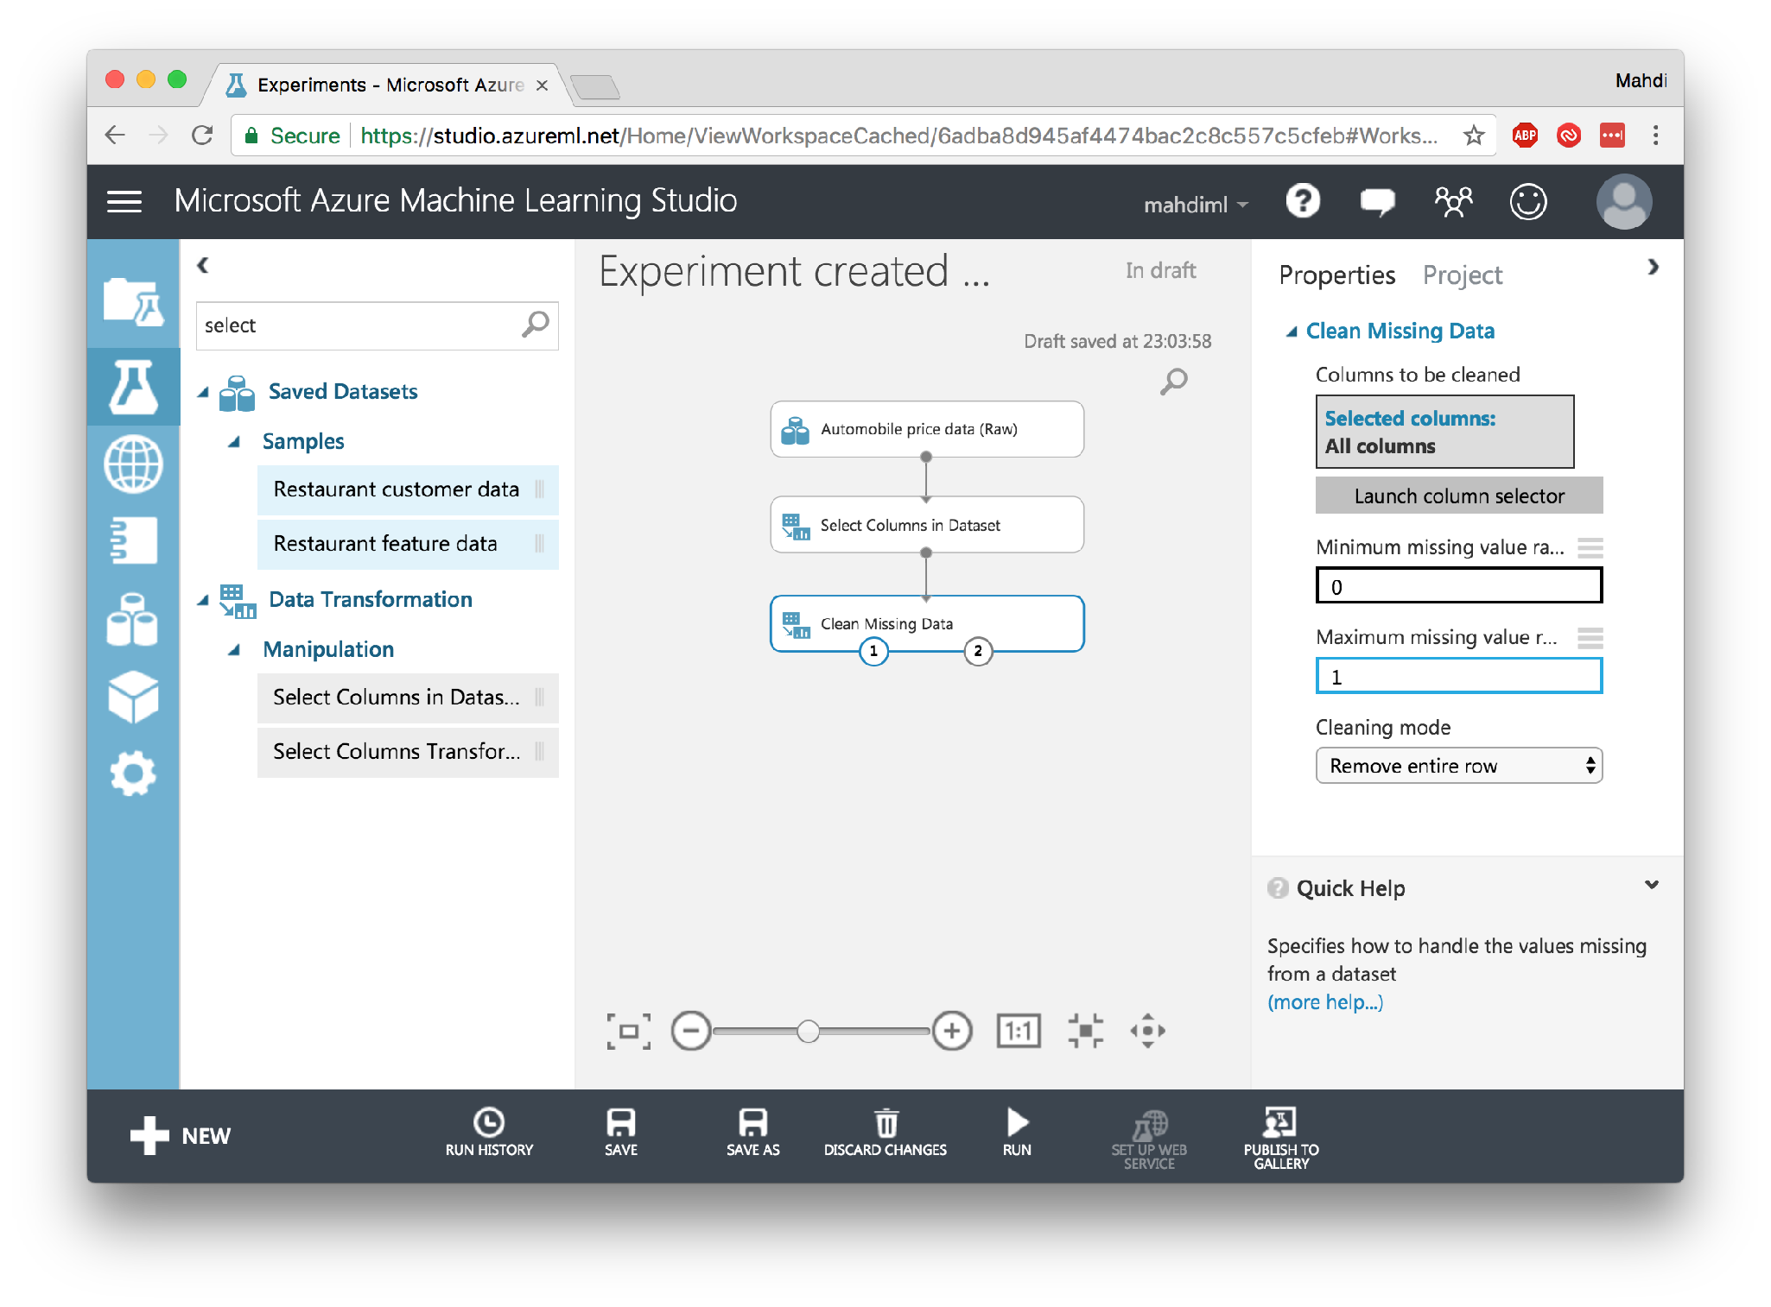

Slide 28
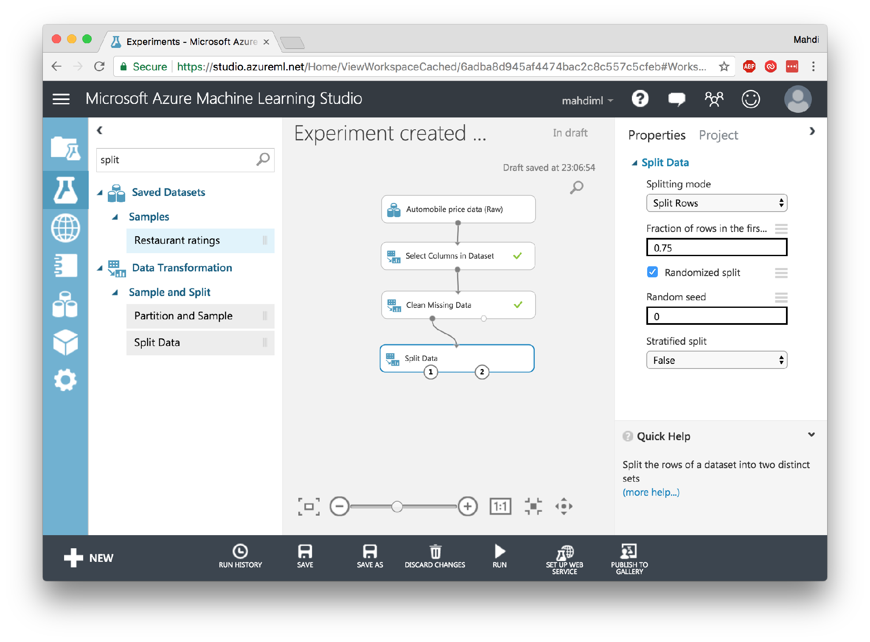

Slide 29
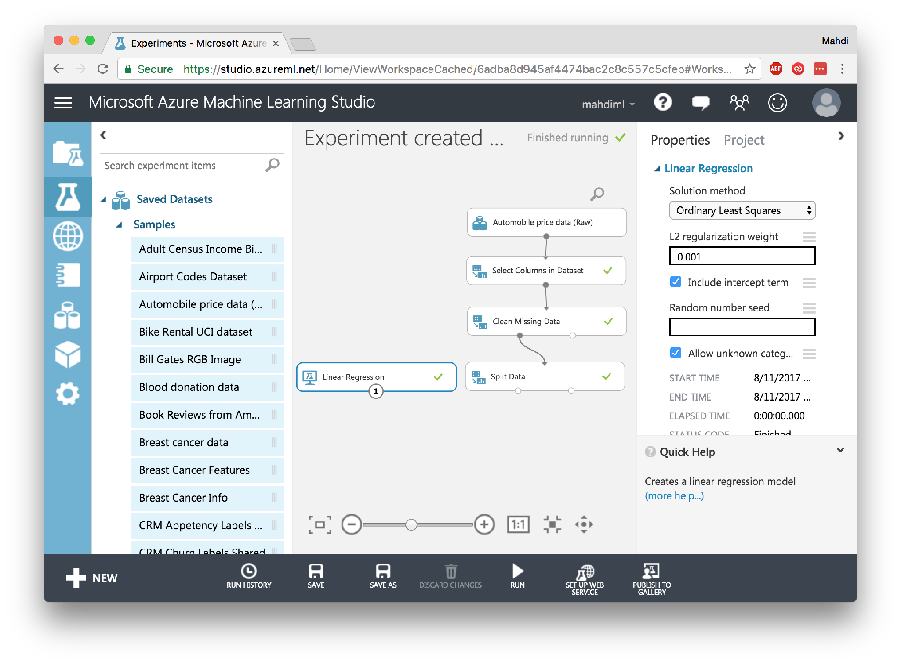

Slide 30
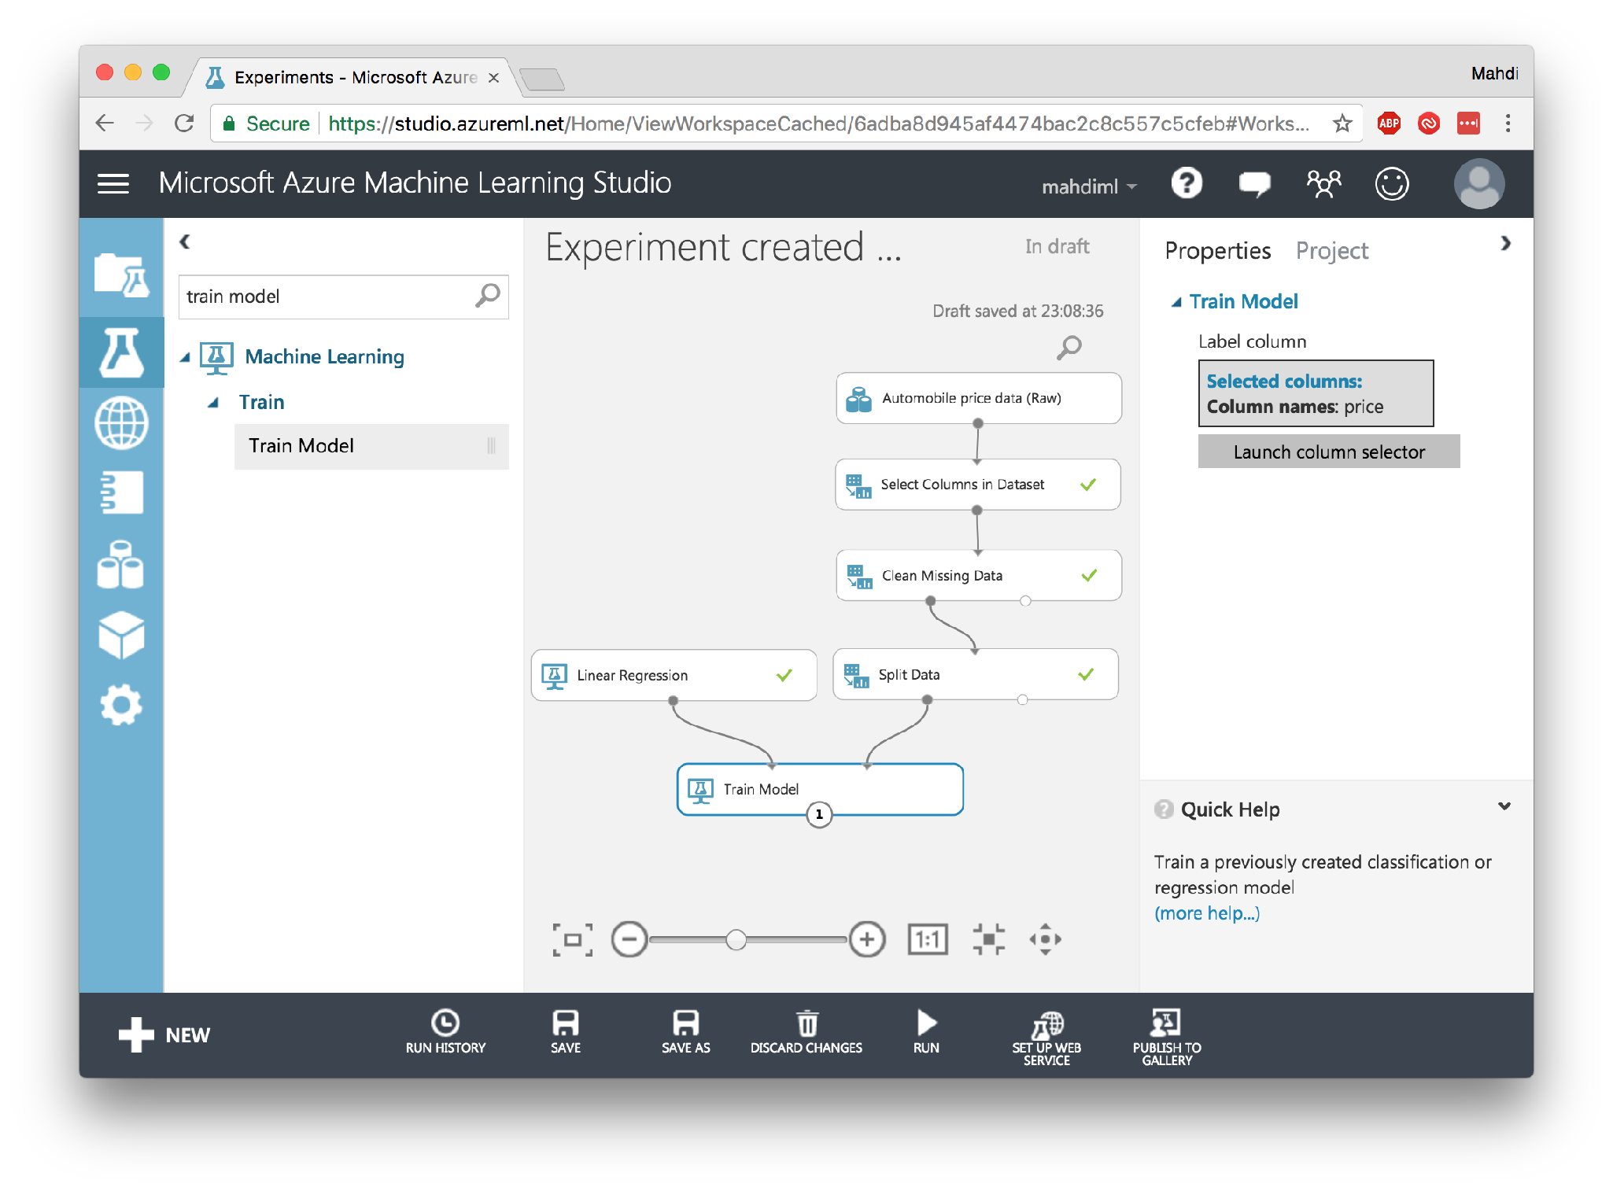

Slide 31
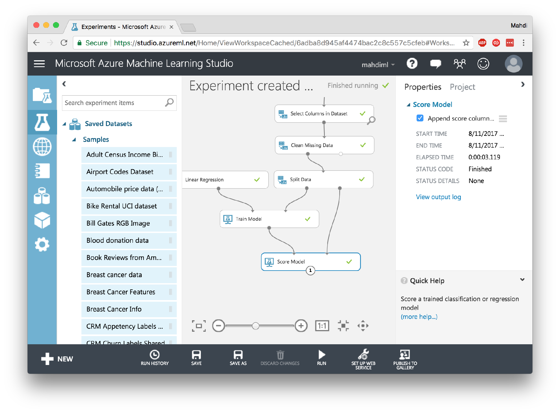

Slide 32
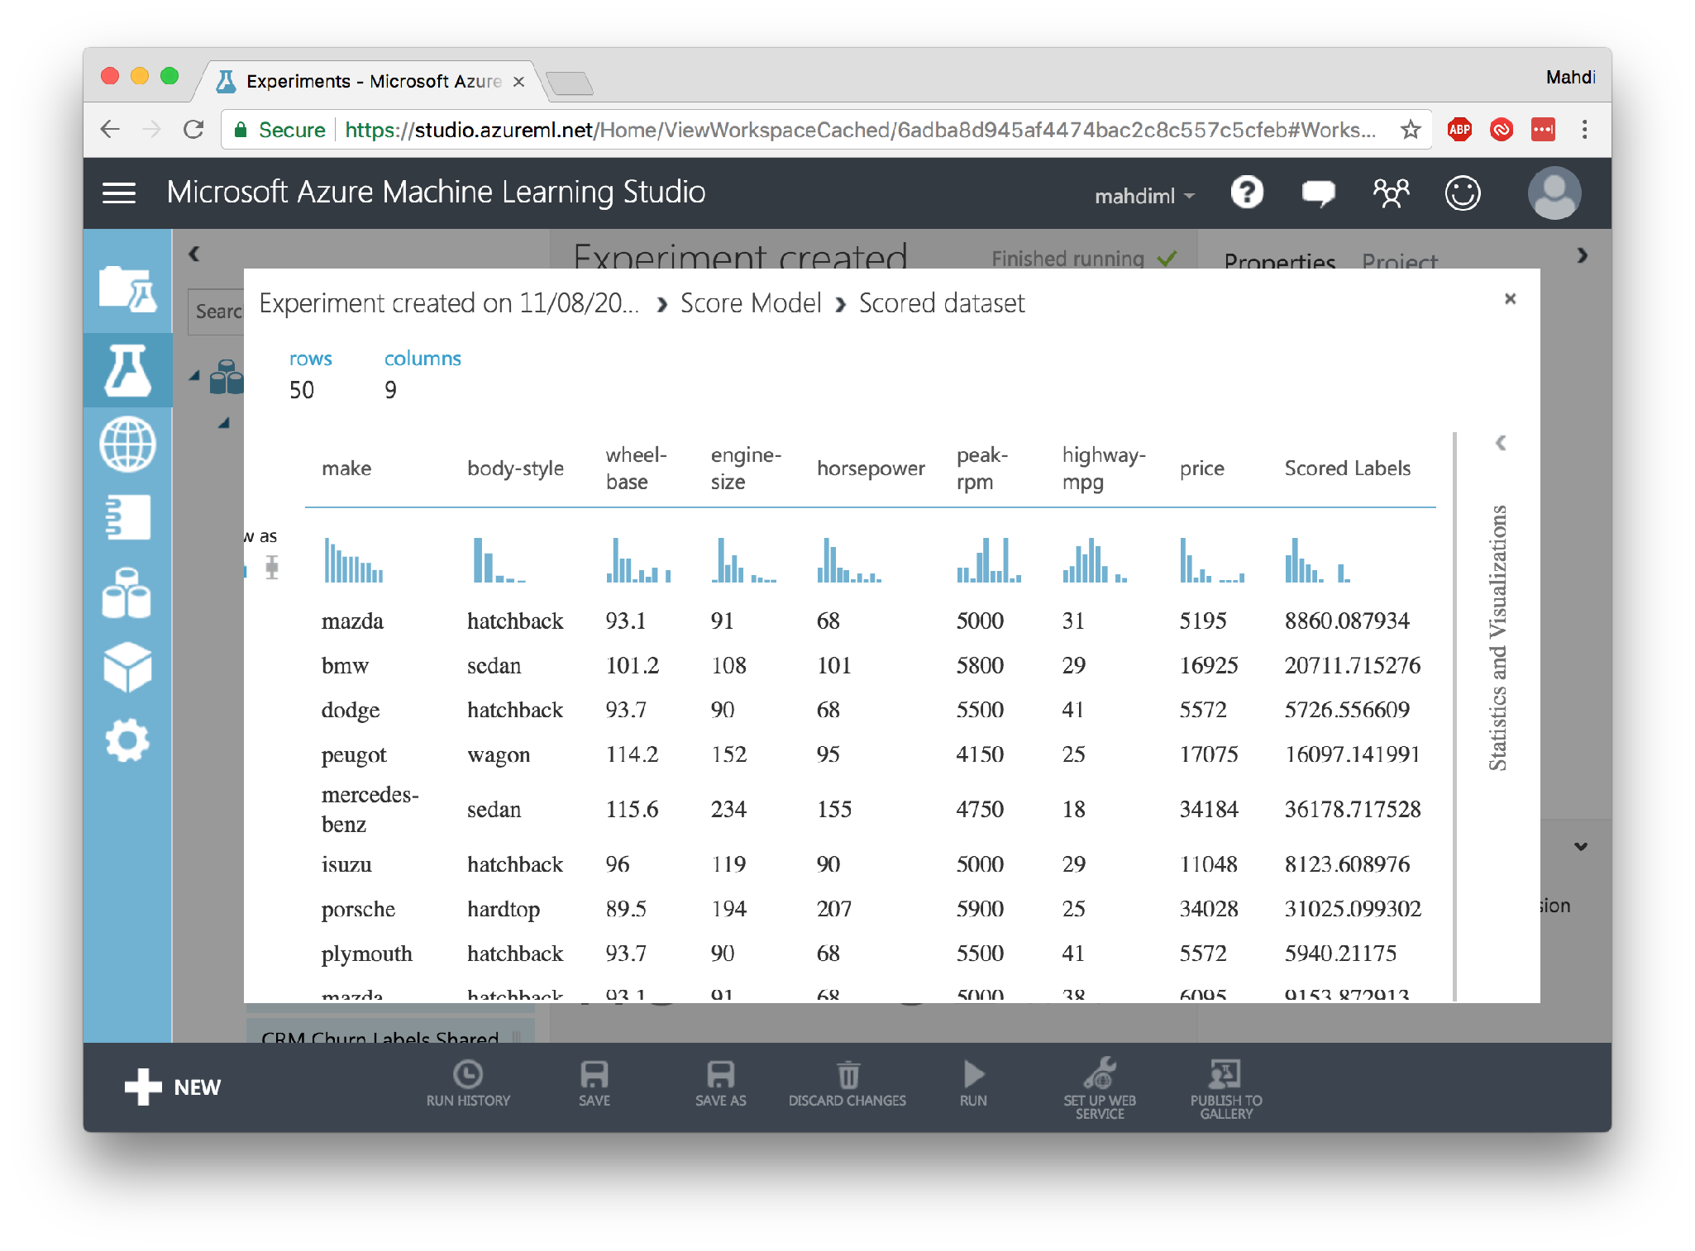

Slide 33
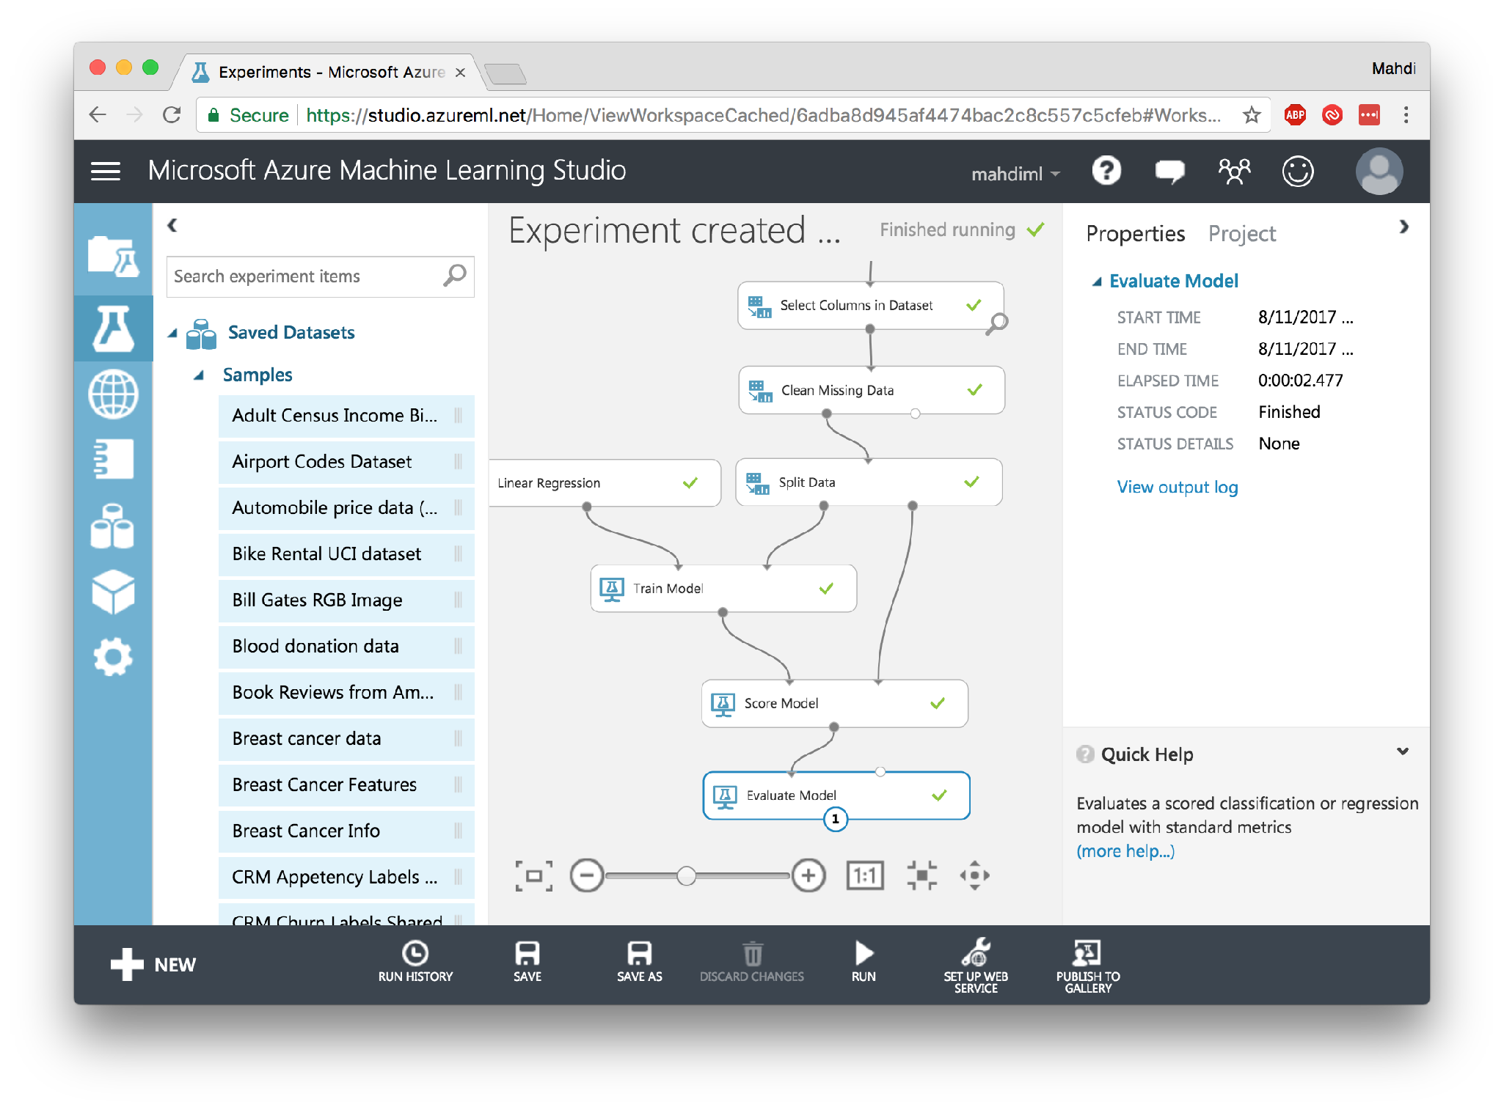

Slide 34
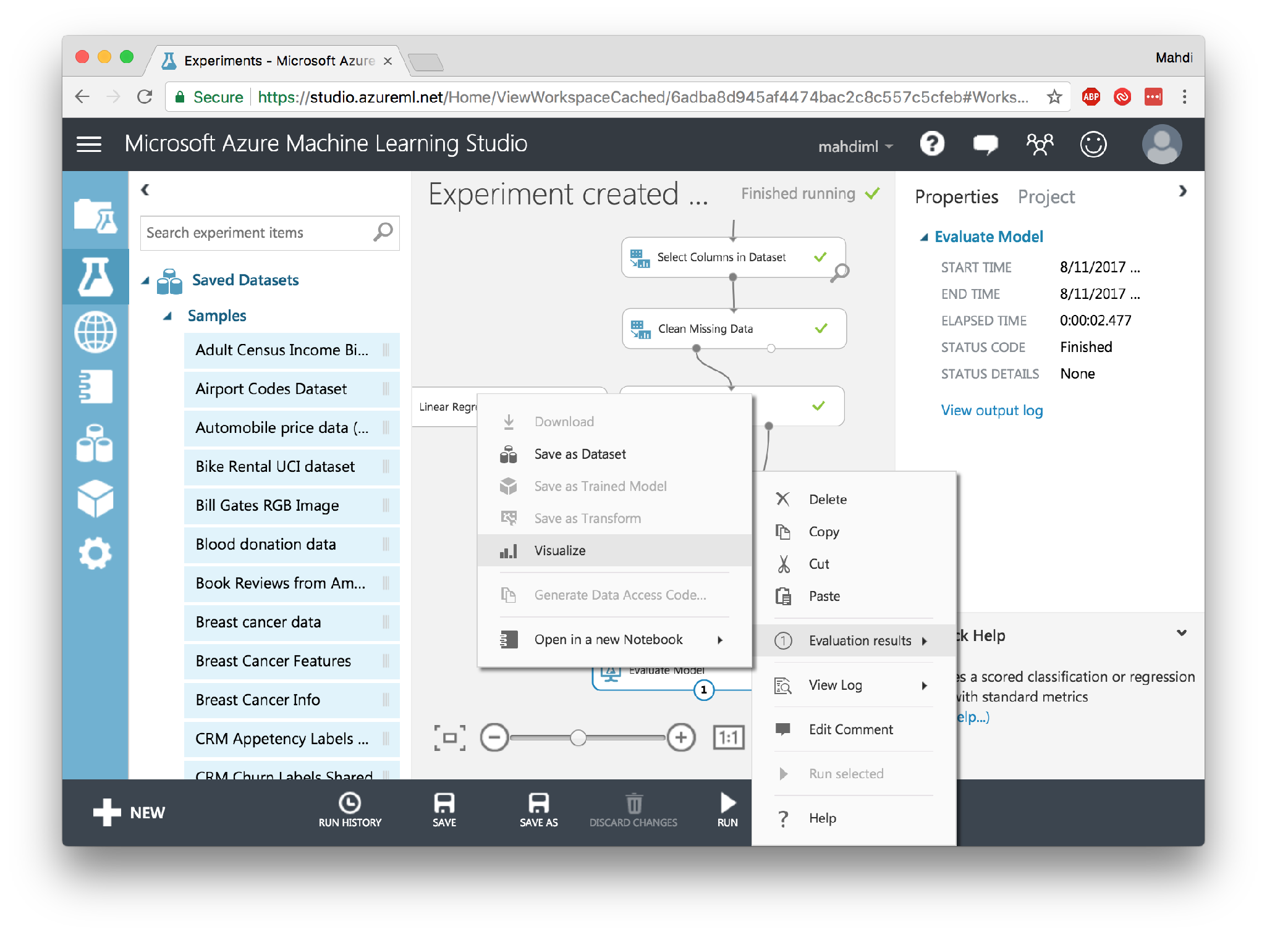

Slide 35
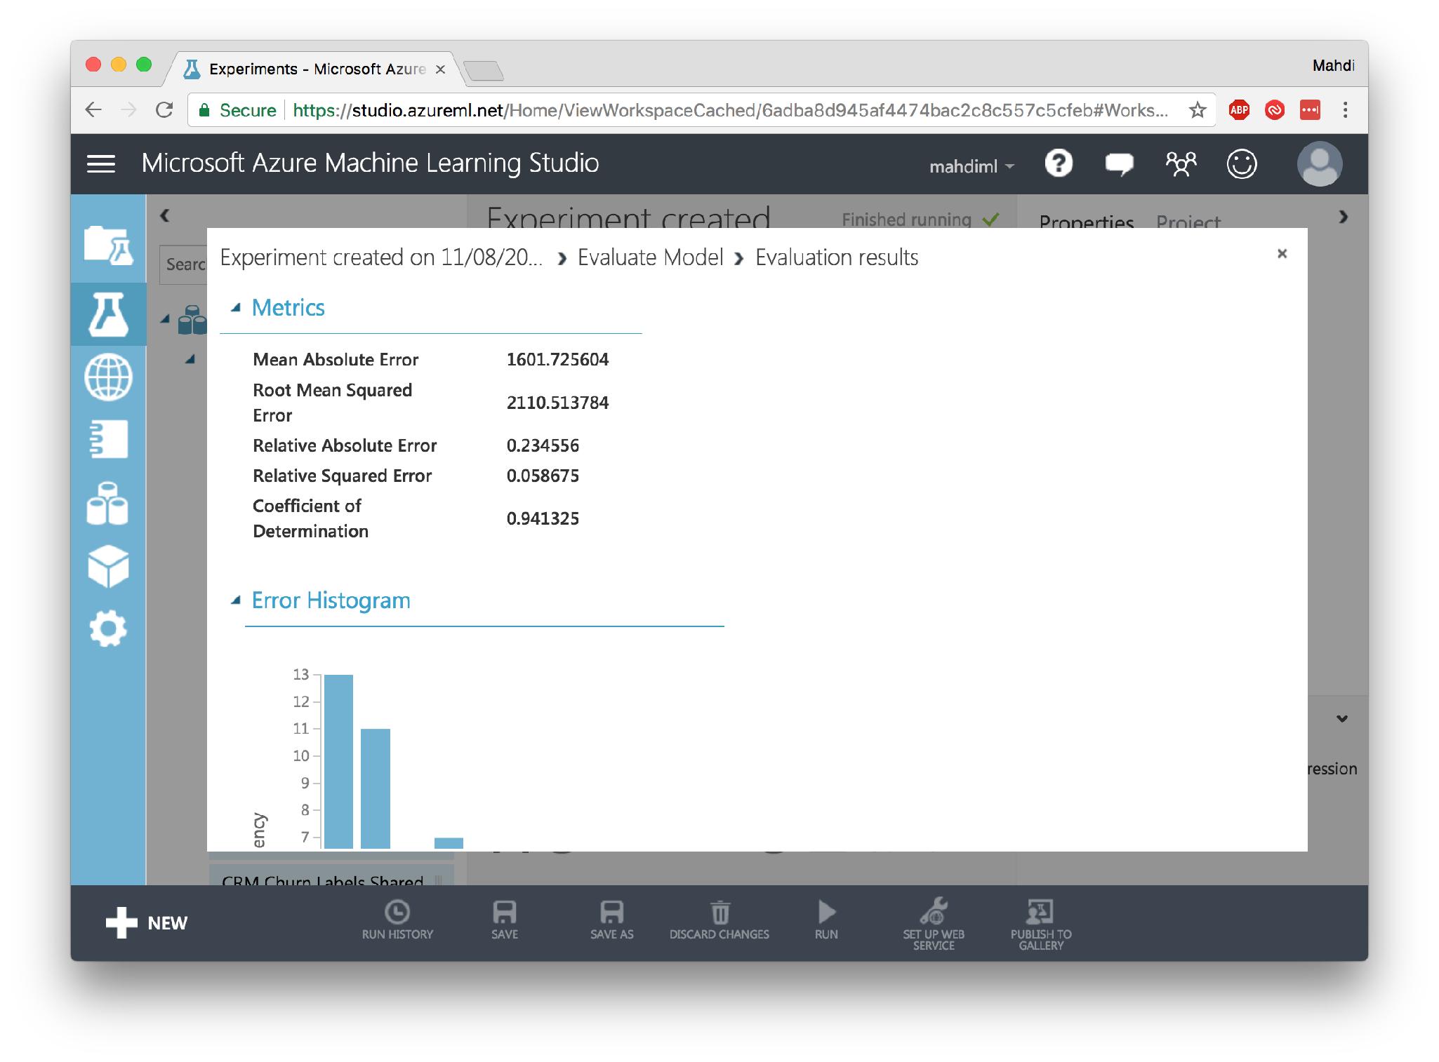

Slide 36
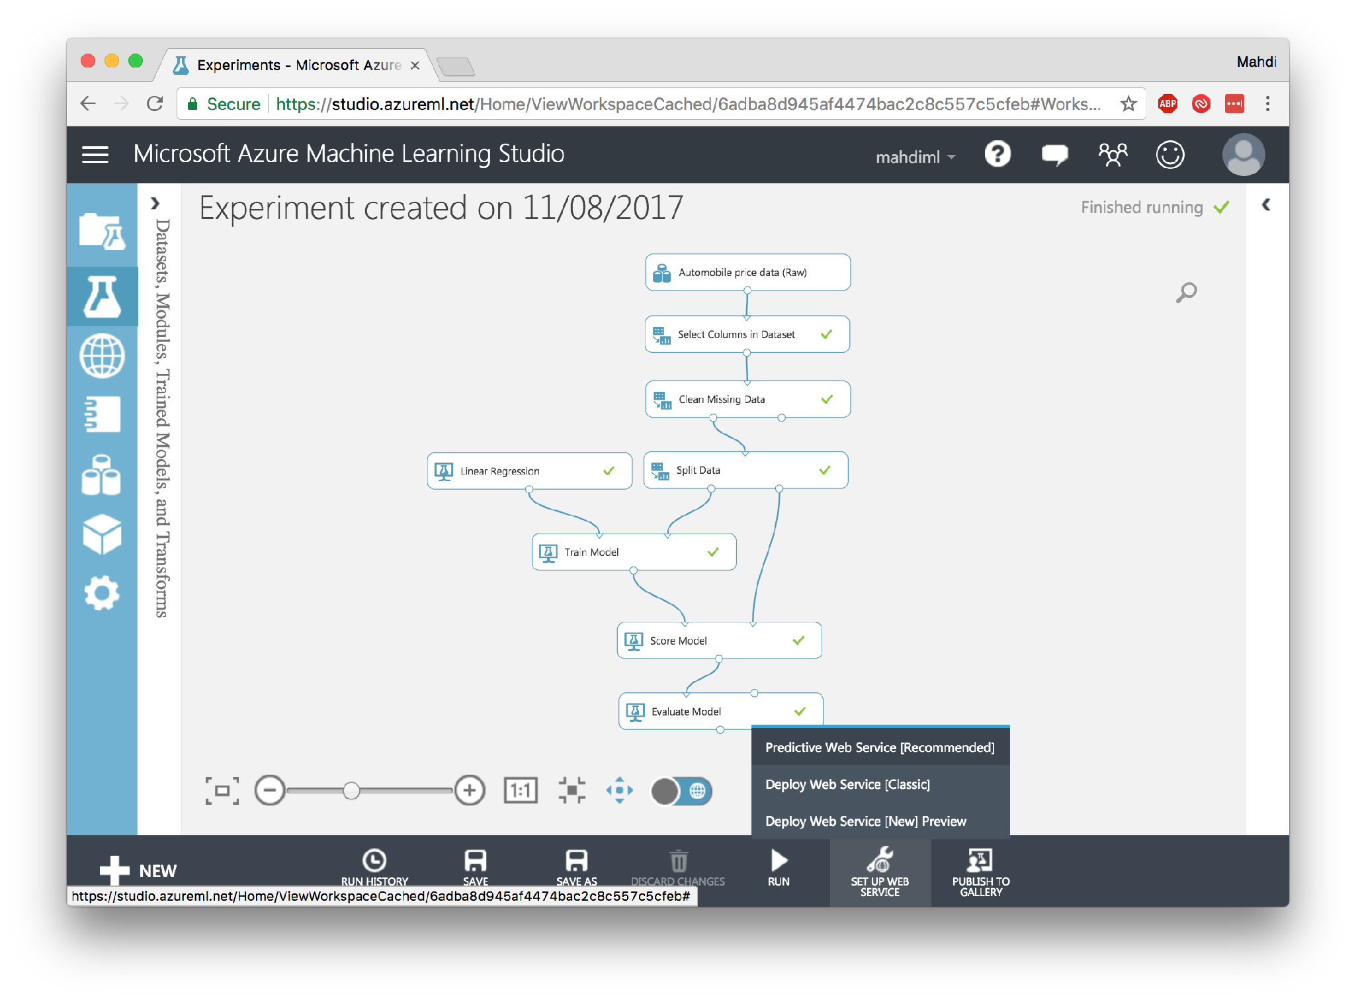

Slide 37
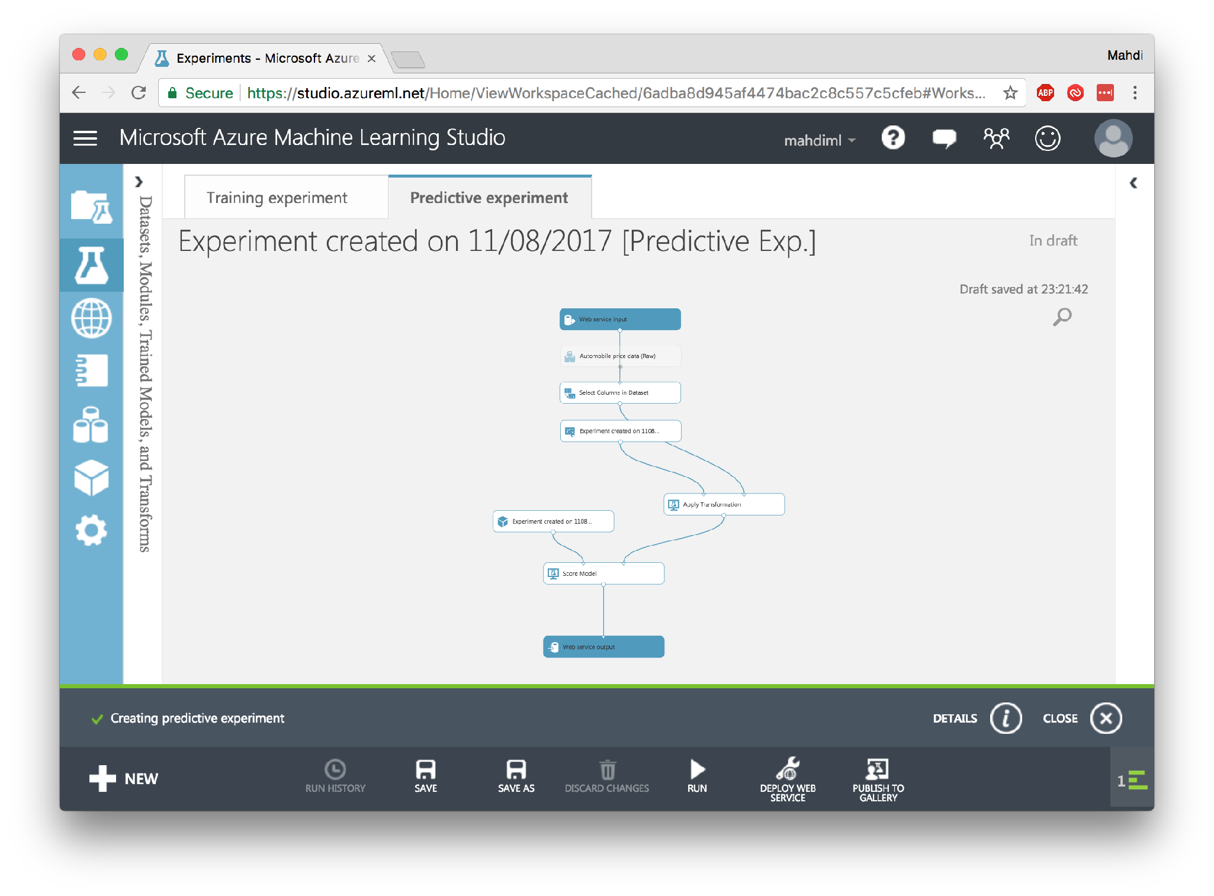

Slide 38
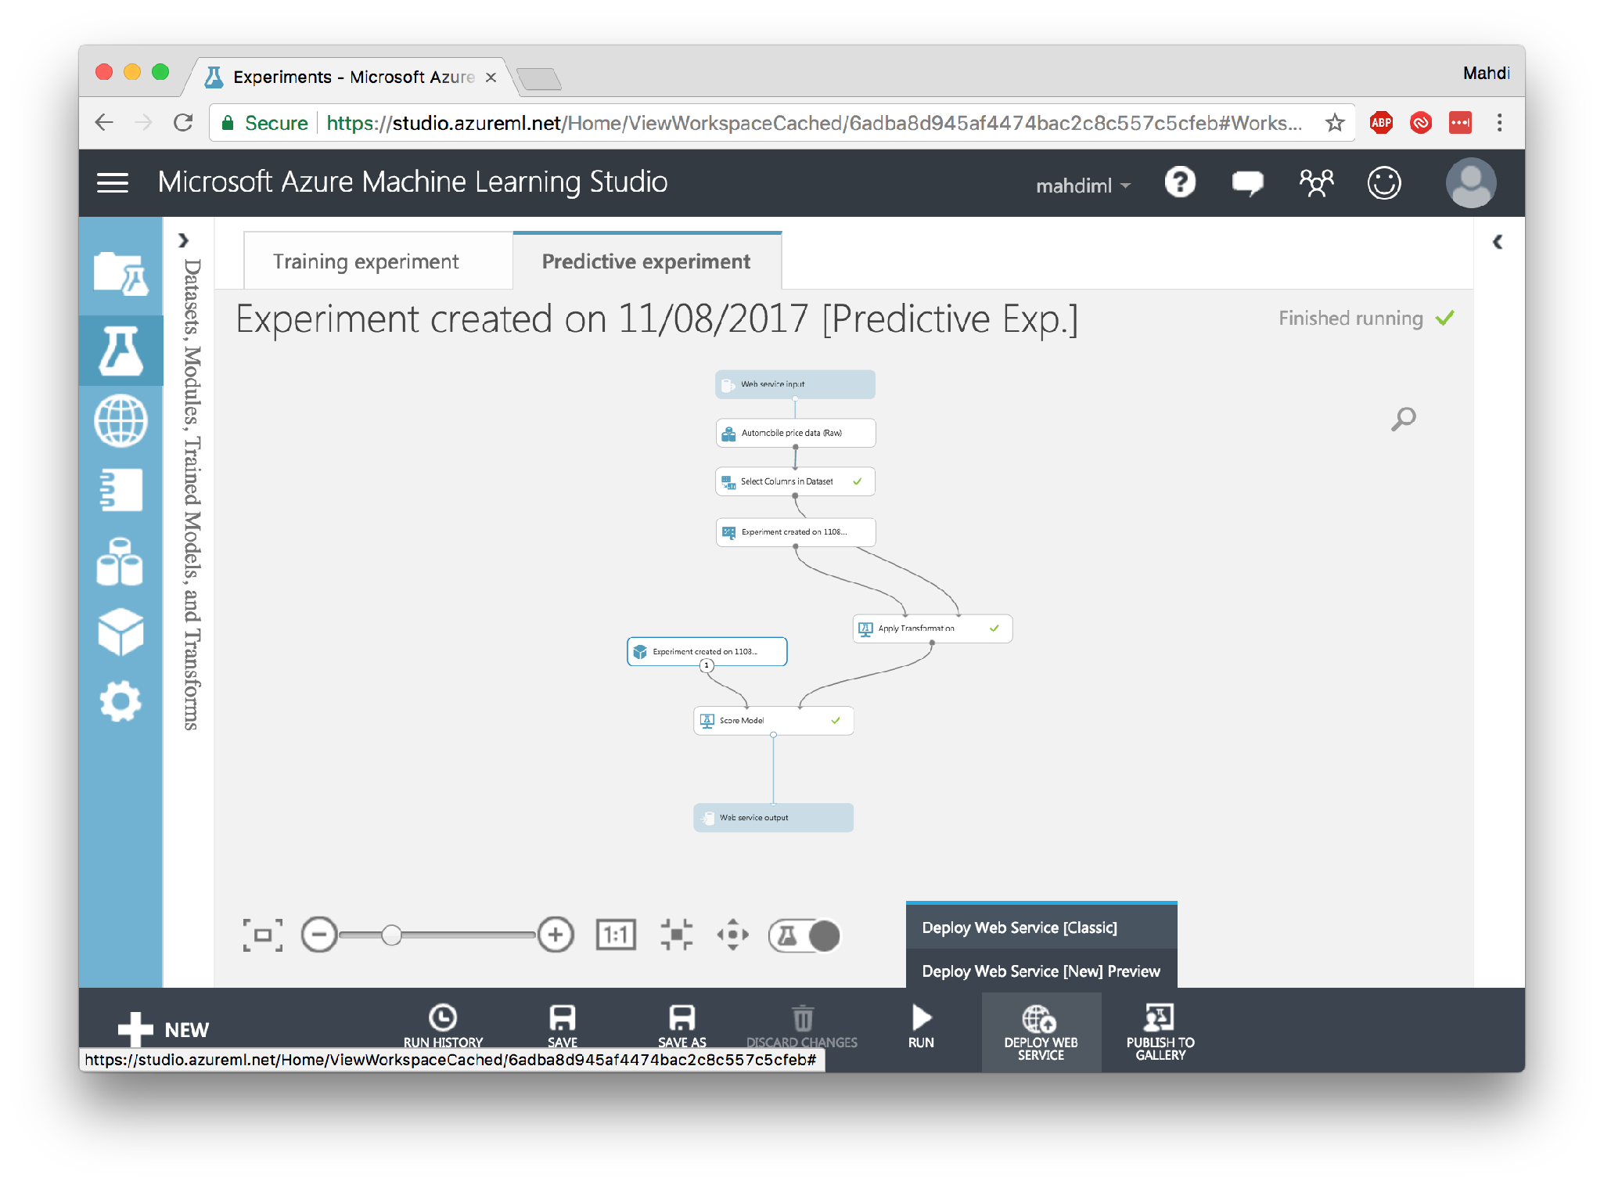

Slide 39
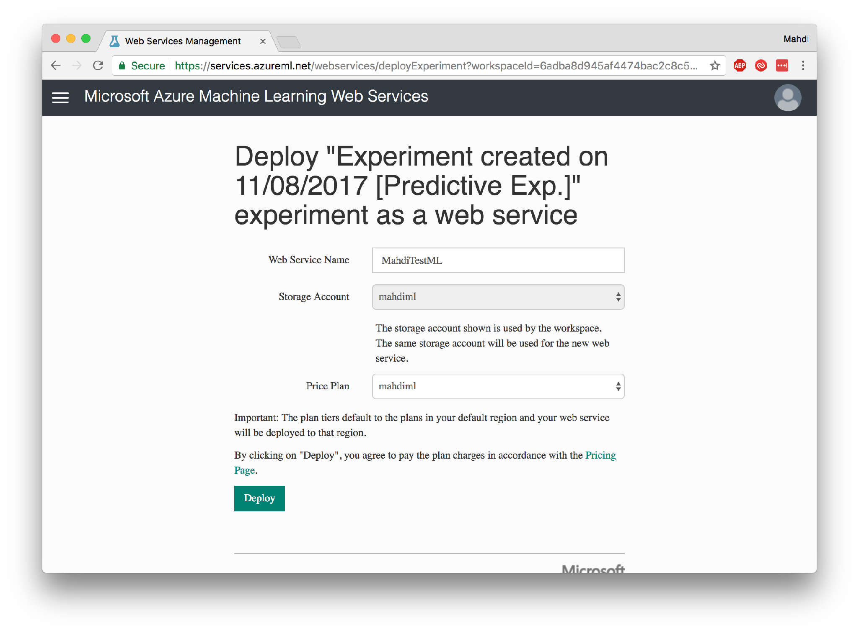

Slide 40
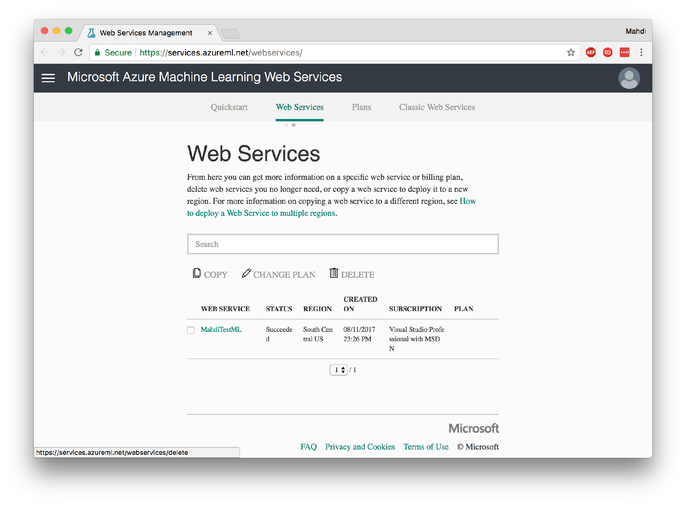

Slide 41
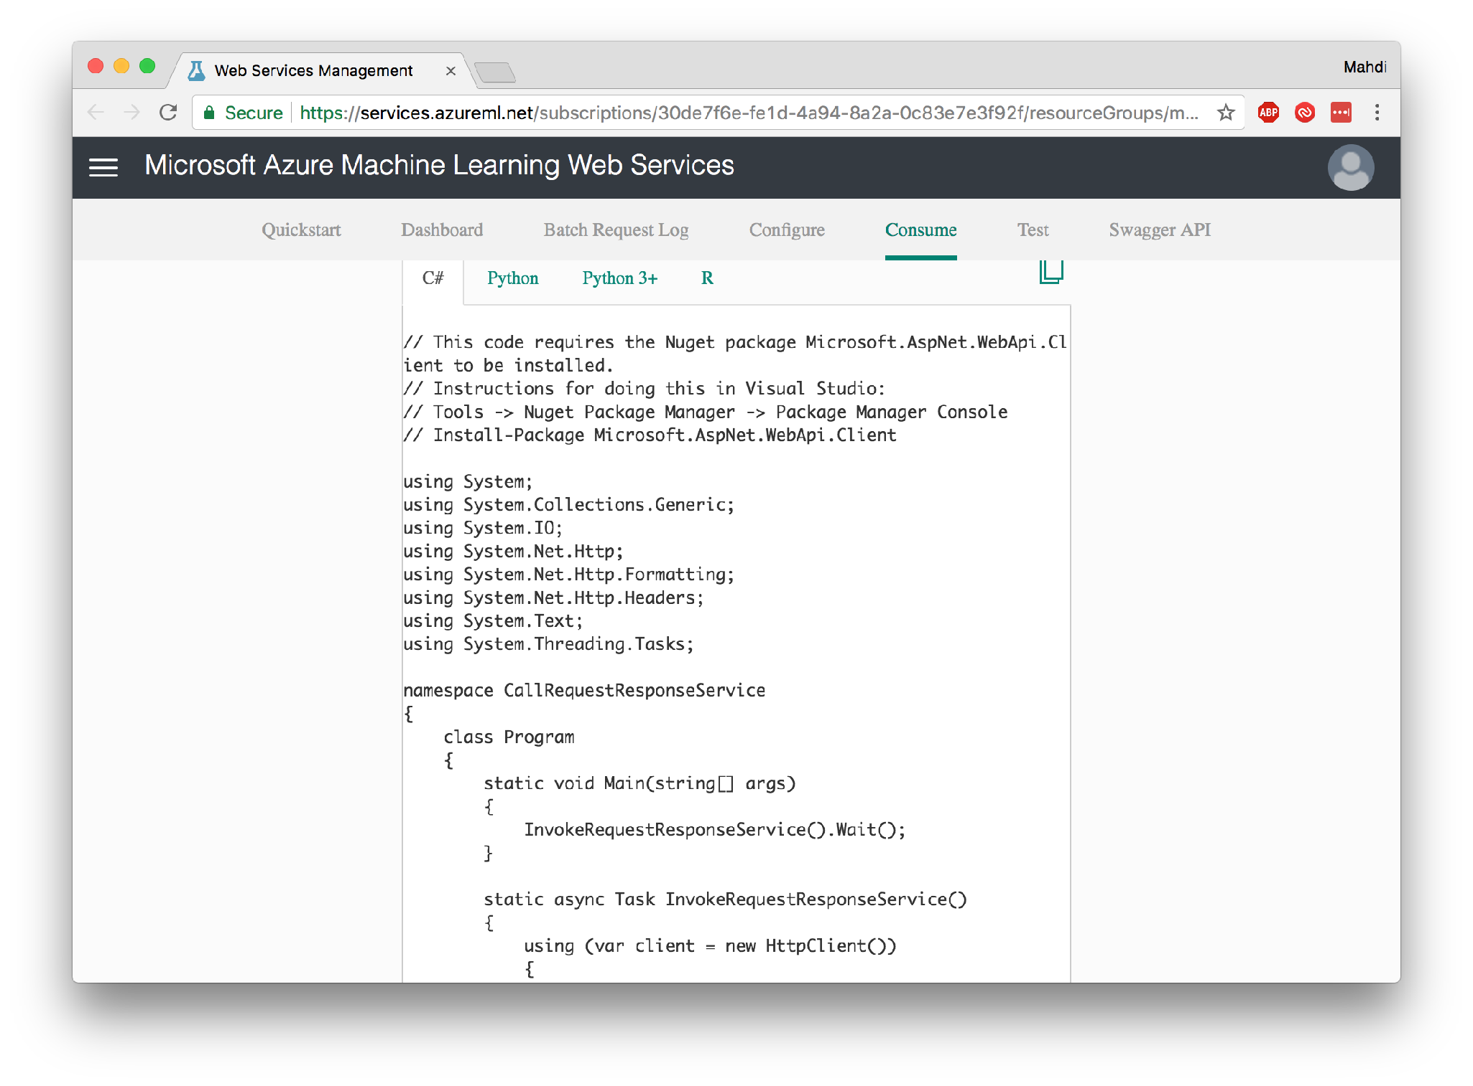

Slide 42
Neural Networks
For Developers*
Universal Function Approximator
* Every single definition may be (i.e. is) inaccurate!

Slide 43

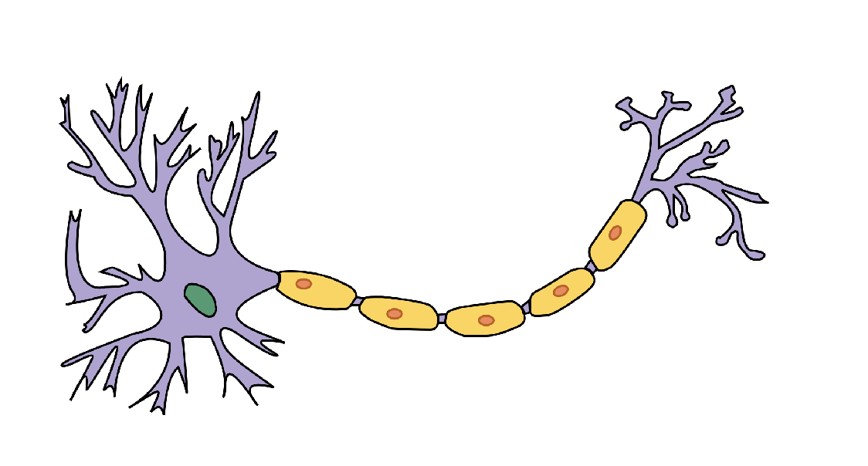
Biological Neuron
Dendrites
(Receivers)
Axon Terminals
(Transmitters)
Axon

Slide 44


Artificial Neuron
Inputs
Weighted sum a.k.a. Logits
Activation function
Output
X1
A potential activation function
W1
Σ
ʃ
Y
W2
X2
Weights
Bias
Sigmoid

Slide 45
Example Neuron
Y = X1 ∧ ~X2
0
10
Σ
-15
0
-10
1
-5
Sigmoid

Slide 46
Example Neuron Y = X1 ∧ ~X2
1
10
Σ
5
1
-10
0
-5
Sigmoid

Slide 47


Simplification
Bias
1
W0
ʃ(Σ)
X1
W1
Y
W2
X2

Slide 48
“Learning” i.e. Adjusting weights
Training data
X0
Output
Adjust weights
to minimise error
W0
ʃ(Σ)
X1
W1
Y
Error Calculation
W2
X2
Y0
Expected Output
Back propagation

Slide 49
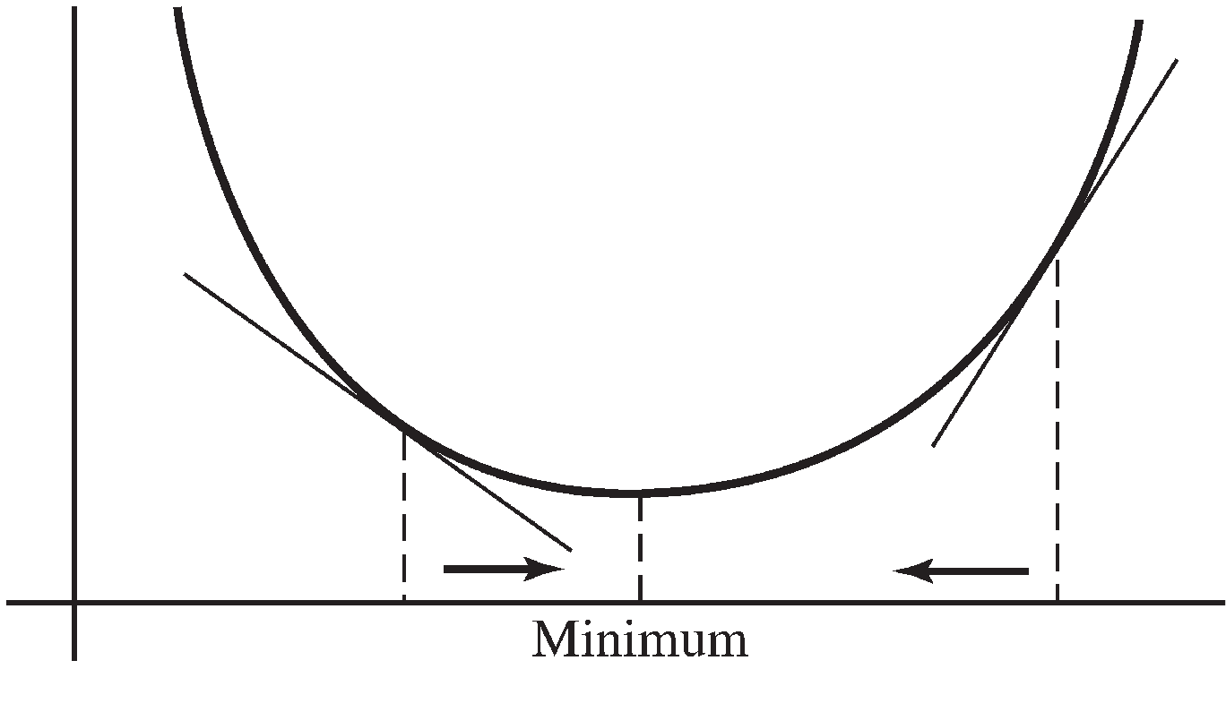
Minimising error using Gradient Descent
Error function a.k.a. (Cost or Loss)
Negative slope Move right
Positive slope Move left
Smaller slope Less adjustment
Larger slope More adjustment

Slide 50

Show me the code!
Learning Rate
Inspired by: https://iamtrask.github.io/2015/07/12/basic-python-network/
Delta rule

Slide 51

Learning Rate
i.e. Speed of Learning
Too Large
Too Small

Slide 52
Neural Network (concept)
Layer 0 (Input Layer)
Layers 1..n-1 (Hidden Layers)
Layer n (Output Layer)
x0
ʃ(Σ)
W000
W001
W100
W002
ʃ(Σ)
ʃ(Σ)
y
W101
W010
W011
W102
x1
ʃ(Σ)
W011

Slide 53
Neural Network (code)
Inspired by: https://iamtrask.github.io/2015/07/12/basic-python-network/

Slide 54
Introduction to TensorFlow
Open source library for numerical computation
Tensor = Multidimensional array (*with transformation)
Flow = Data flow graph
Developed by Google Brain Team
Initial release: Nov 2015, V1.0.0 release: Feb 2017
Support for multiple CPU, GPU and TPU*
Available on Linux, macOS, Windows, Android, iOS
API for Python, C++, Java, Go (Third party API for C#, Ruby, Scala, …)
* TPU = Tensor Processing Unit

Slide 55
TensorFlow Basics
Define the model (graph)
Nodes: Operations
Edges: Data (Tensors)
Execute the model
Create a new Session and run the model
Session allocates resources

Slide 56
Simple NN in TensorFlow

Slide 57
Visualisation (TensorBoard)

Slide 62
Visualising the graph

Slide 65
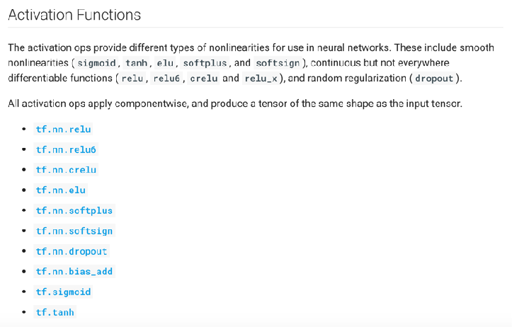
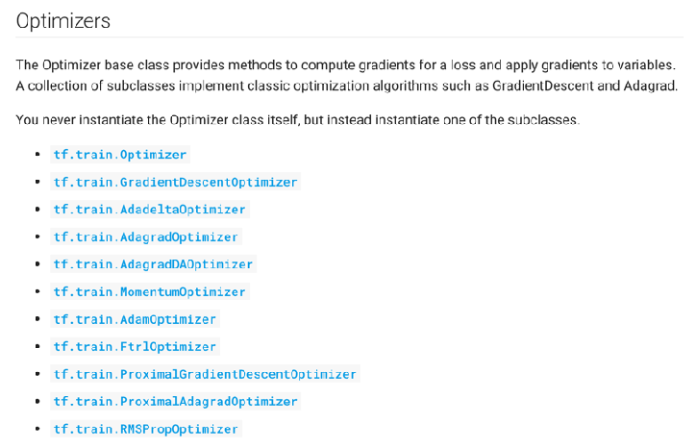
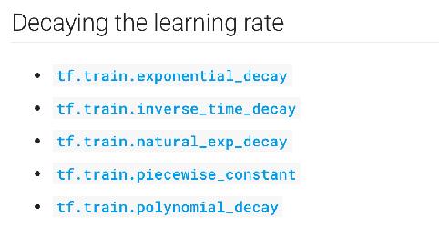
You have options!
Activation function
Hidden layers: tf.nn.relu
Output layer:
Classification: tf.nn.softmax
Regression: Linear function
Optimisers
Learning Rates

Slide 66
And there is a lot to learn!
Input normalisation
Mini-batching
Dropout
Initialising weights
Cross-entropy loss function
Re-training
…

Slide 67
More than “vanilla” NN
Convolutional neural network (ConvNet):
Recognise patterns across space (images and videos processing)
Recurrent neural network (RNN) and LSTM:
Recognise patterns across time (text and speech analysis)
Autoencoder:
Learn a representation (encoding) for a set of data (dimensionality reduction, information retrieval and search)
Restricted Boltzmann machine
Learns to generate new values based on past observations

Slide 68
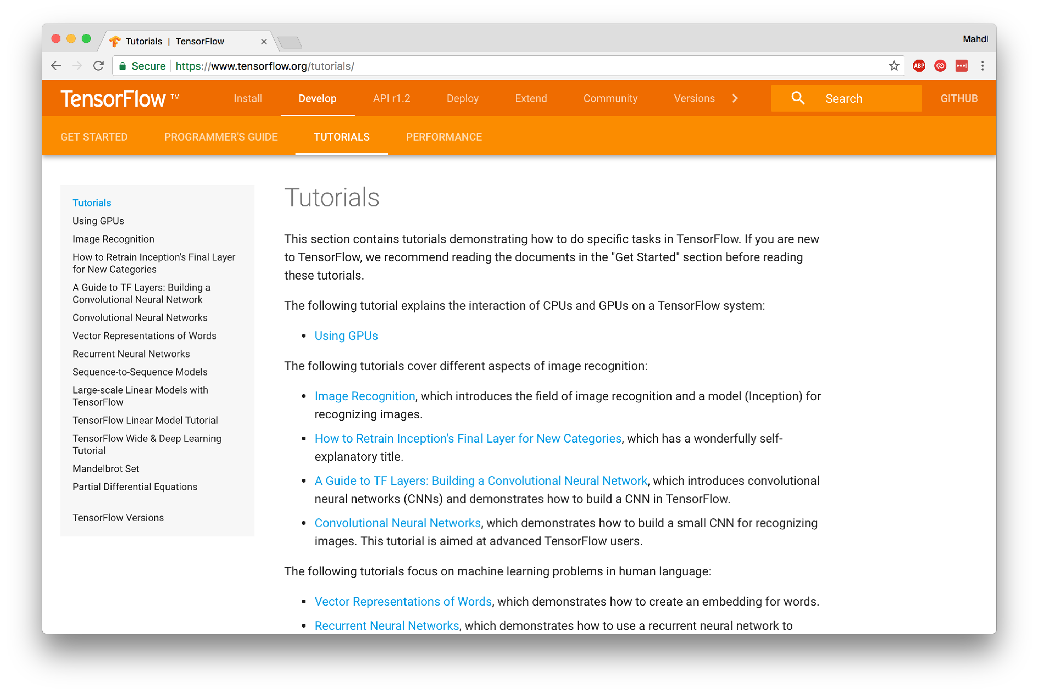
Where to go now?

Slide 69
